Slide 1
FaFi
Team 5

Slide 2
Table of Contents
SDD Overview
STD Overview

Slide 3
Application Introduction
frame
The FaFi application implements the YOLOv5 pre-trained model to detect any person objects in a live streaming video through the computer's camera.
A Surveillance mode can be turned on and stores a snapshot of the video along with other information whenever people are detected inside the video, then an email notification will be sent to the email on file.
The design goal of FaFi are the following:
Efficiency- The ML algorithm used in this application must be efficient.
Reliability- The people detection and email notification must be reliable.
Security- The security of the end user’s account and the privacy of the history must be secured.
Robustness- The application must be able to run in all environments, handle errors, be fault tolerant and pass thorough testing.

Slide 4
Software Architecture SDD
frame
Front end - Flask, Flask-Login, Flask-Mail
Back end server - SQlite3, Flask Framework
ML framework - Pytorch, OpenCV

Slide 5
Class Diagram SDD
frame
Entities:
FaFI Web Application
Images
Facial detection results
Users
Controls:
Login
Upload File
Label prediction for model training
View History
ML Facial detection
Boundaries:
Main Menu interface
LoginPage
SignupPage
HistoryPage
ConfigPage

Slide 6
UI Design SDD
frame
Login page - Users can create and login to their account
Fields: Username and Password
Buttons: Create Account and Sign In
Create Account redirects to Sign Up page
Sign In redirects to Home Page
Sign Up page - User creates a username and password for their account
Fields: Username and Password
Button: Submit
Submit redirects to Login Page. Accounts with passed username and password are created.
All Pages hereafter:
Navigation Bar: Links to Home, History, and Notifications tabs
Main page
Functionalities:
Displays the live stream video with people detection feature
Upload an image for facial detection

Slide 7
UI Design continued
frame
History page- Displays a history of events where people are detected.
Buttons: Click on an event to view the screenshot enlarged.
History Feature: Each event shows a screenshot on the left with time it took place, and number of people detected on the right.
Notification page- A page that an end user can turn on the “surveillance” feature and enter an email address for potential notifications from the application.
Fields: Email Address to receive notifications
Buttons:
Surveillance Feature: An end user can set up a time frame that if the application detects any people within that time period, toggle email notification will be sent to the user's email address, and a screen shot of a video will be saved and stored in the History page.

Slide 8
Database Design
frame
The Database Design will consist of a single table. This table will be created natively in python using the SQLite3 module.
This table will house metadata about the uploaded image including attributes like person detected or not, unique identifying code, and timestamp.
This SQL Database will then be used by the history tab, notification tab and future features.

Slide 9
Security Design
frame
We plan to implement an authentication mechanism to prevent unauthenticated use of our application by creating a username and password.
These values will be encrypted and stored within our database.
We’ll make use of the flask-login plugin to provide user session management.

Slide 10
ML Algorithm
frame
Please refer to object_detection.py

Slide 11
Testing Responsibilities
Unit Tests will be written by each member for the functions that they code.
Integration, Regression, System, and Acceptance tests will be lead by the QA leader.

Slide 12
Test Types
Unit Tests
PyTest assert function outputs with expected results
Regression Tests
PyTest GET and POST requests to flask web application
Check if response STATUS CODE = 200 OK
Ensures code change does not break web application
System and Acceptance Testing
Assume the role of a user and interact with web app
Login
Visit different tabs
Trigger ML detection
View history

Slide 13
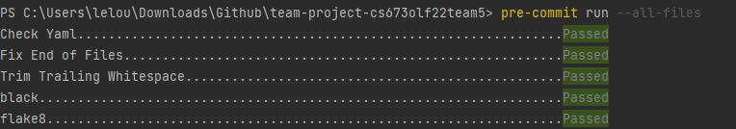
Automated Testing - Pre-Commit
Use pre-commit to set up Git hooks
Runs automatically every time we commit a code change
Flake8 checks for PEP8 Standards
Black parses and updates code styling

Slide 14
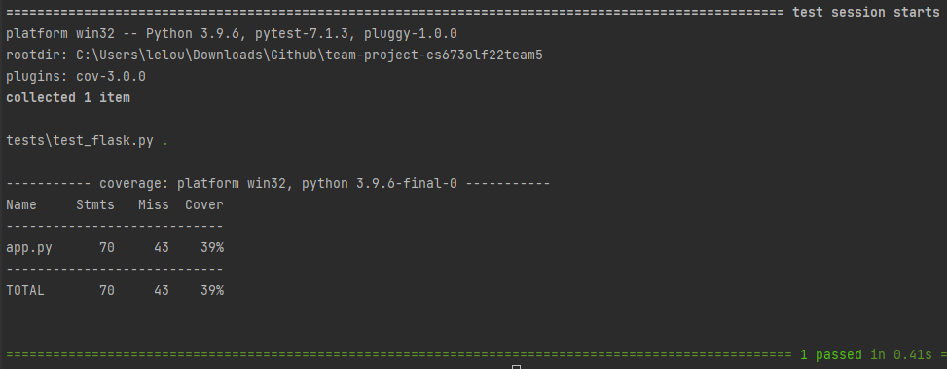
Automated Testing - Pytest
Main Testing Framework
Used to write Unit Tests and Regression Tests
asserting function output against expected result
assert request response against web application
Integrate PyTest-Cov plugin for code coverage

Slide 15
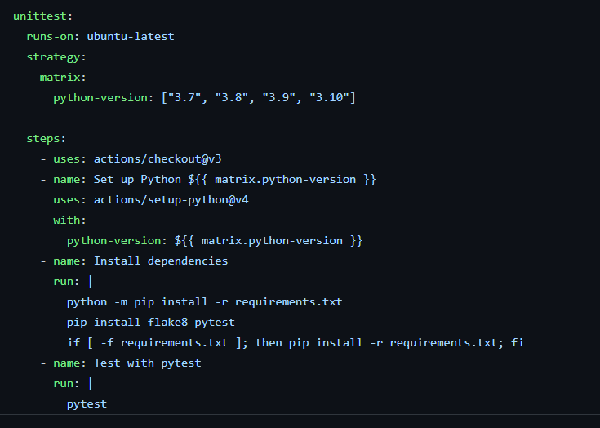
Automated Testing - Github Actions
Plans to use Github Actions
Trigger CI/CD workflow to lint and run tests on each PR
Runs workflow on a remote runner
Ensures tests must pass before a code change
Enables linting of code before a merge to main
Github Actions Config

Slide 16
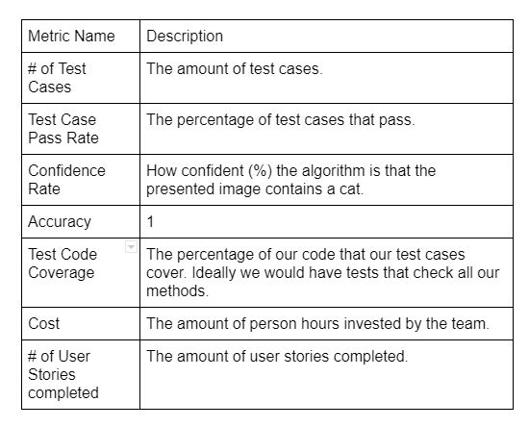
Testing Metrics

Slide 17
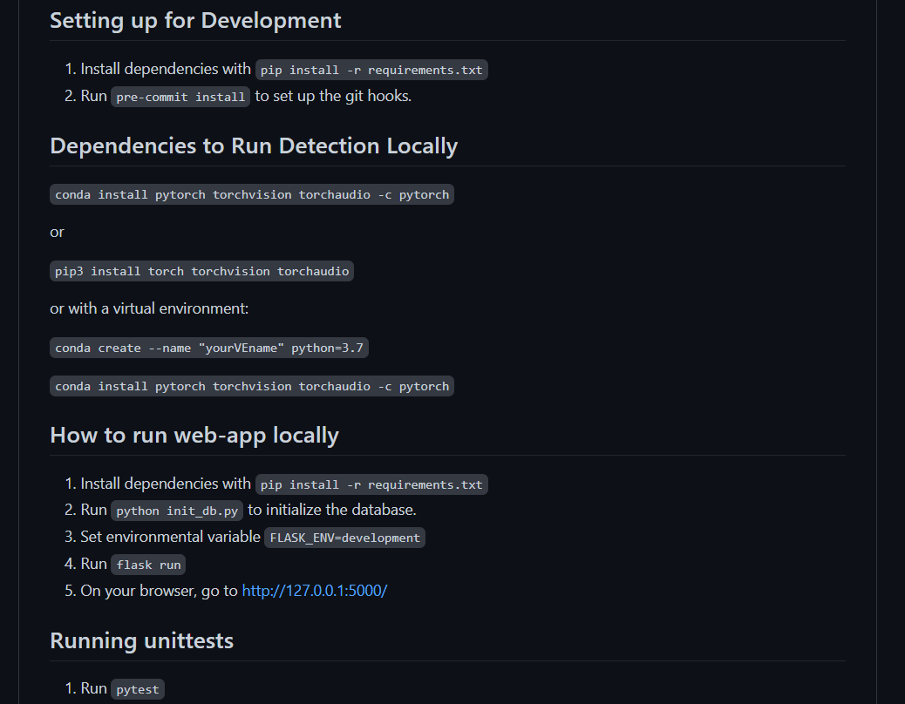
Runnable Code - README.md

